Slide 1

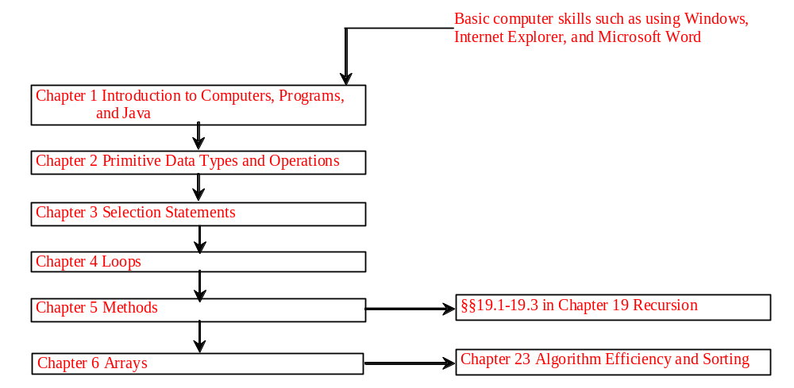
Chapter 2 Primitive Data Types and Operations

Slide 2
Objectives
To write Java programs to perform simple calculations (§2.2).
To use identifiers to name variables, constants, methods, and classes (§2.3).
To use variables to store data (§2.4-2.5).
To program with assignment statements and assignment expressions (§2.5).
To use constants to store permanent data (§2.6).
To declare Java primitive data types: byte, short, int, long, float, double, and char (§2.7 – 2.10).
To use Java operators to write expressions (§2.7 – 2.9).
To represent a string using the String type. (§2.10)
To obtain input using the JOptionPane input dialog boxes (§2.11).
(Optional) To obtain input from console (§2.13).
To become familiar with Java documentation, programming style, and naming conventions (§2.14).
To distinguish syntax errors, runtime errors, and logic errors (§2.15).
To debug logic errors (§2.16).

Slide 3
Introducing Programming with an Example
Listing 2.1 Computing the Area of a Circle
This program computes the area of the circle.
ComputeArea
IMPORTANT NOTE: To run the program from the Run button, (1) set c:\Program Files\java\jdk1.5.0\bin for path, and (2) install slides from the Instructor Resource Website to a directory (e.g., c:\LiangIR) .
Run

Slide 4
Identifiers
An identifier is a sequence of characters that consist of letters, digits, underscores (_), and dollar signs ($).
An identifier must start with a letter, an underscore (_), or a dollar sign ($). It cannot start with a digit.
  An identifier cannot be a reserved word. (See Appendix A, “Java Keywords,” for a list of reserved words).
An identifier cannot be true, false, or
null.
An identifier can be of any length.

Slide 5
Variables
// Compute the first area
radius = 1.0;
area = radius * radius * 3.14159;
System.out.println("The area is “ + area + " for radius "+radius);
// Compute the second area
radius = 2.0;
area = radius * radius * 3.14159;
System.out.println("The area is “ + area + " for radius "+radius);

Slide 6
Declaring Variables
int x; // Declare x to be an
// integer variable;
double radius; // Declare radius to
// be a double variable;
char a; // Declare a to be a
// character variable;

Slide 7
Assignment Statements
x = 1; // Assign 1 to x;
radius = 1.0; // Assign 1.0 to radius;
a = 'A'; // Assign 'A' to a;

Slide 8
Declaring and Initializing in One Step
int x = 1;
double d = 1.4;

Slide 9
Constants
final datatype CONSTANTNAME = VALUE;
final double PI = 3.14159;
final int SIZE = 3;

Slide 10
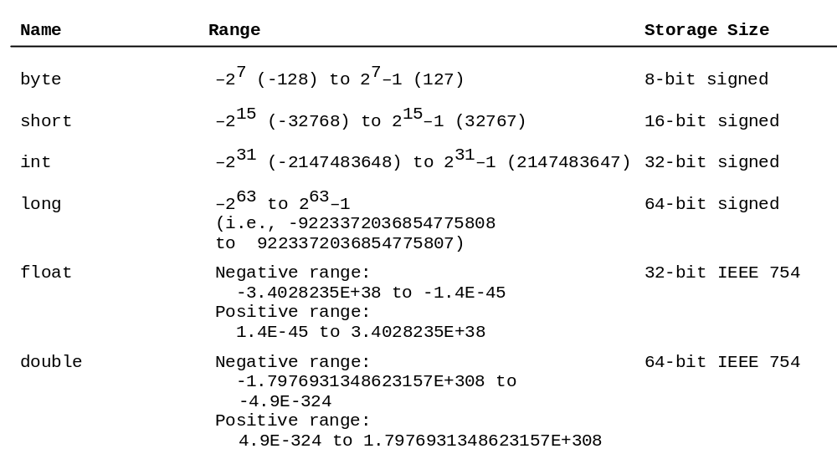
Numerical Data Types

Slide 11
TIP
An excellent tool to demonstrate how numbers are stored in a computer was developed by Richard Rasala. You can access it at
http://www.ccs.neu.edu/jpt/jpt_2_3/bitdisplay/applet.htm

Slide 12
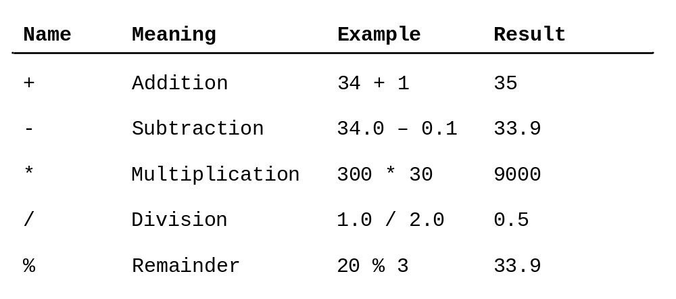
Numeric Operators

Slide 13
Integer Division
+, -, *, /, and %
5 / 2 yields an integer 2.
5.0 / 2 yields a double value 2.5
5 % 2 yields 1 (the remainder of the division)

Slide 14
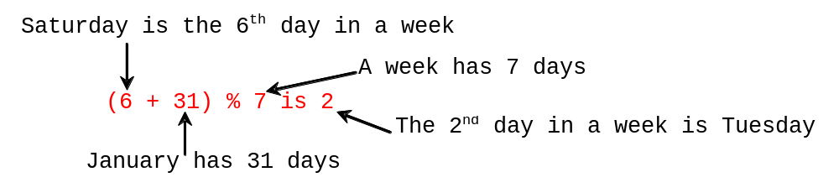
Remainder Operator
Remainder is very useful in programming. For example, an even number % 2 is always 0 and an odd number % 2 is always 1. So you can use this property to determine whether a number is even or odd. Suppose today is Saturday and you and your friends are going to meet in 10 days. What day is in 10 days? You can find that day is Tuesday using the following expression:

Slide 15
Example: Displaying Time
Write a program that obtains hours and minutes from seconds.
DisplayTime
Run

Slide 16
NOTE
Calculations involving floating-point numbers are approximated because these numbers are not stored with complete accuracy. For example,
System.out.println(1.0 - 0.1 - 0.1 - 0.1 - 0.1 - 0.1);
displays 0.5000000000000001, not 0.5, and
System.out.println(1.0 - 0.9);
displays 0.09999999999999998, not 0.1. Integers are stored precisely. Therefore, calculations with integers yield a precise integer result.

Slide 17
Number Literals
A literal is a constant value that appears directly in the program. For example, 34, 1,000,000, and 5.0 are literals in the following statements:
int i = 34;
long x = 1000000;
double d = 5.0;

Slide 18
Integer Literals
An integer literal can be assigned to an integer variable as long as it can fit into the variable. A compilation error would occur if the literal were too large for the variable to hold. For example, the statement byte b = 1000 would cause a compilation error, because 1000 cannot be stored in a variable of the byte type.
An integer literal is assumed to be of the int type, whose value is between -2³¹ (-2147483648) to 2³¹–1 (2147483647). To denote an integer literal of the long type, append it with the letter L or l. L is preferred because l (lowercase L) can easily be confused with 1 (the digit one).

Slide 19
Floating-Point Literals
Floating-point literals are written with a decimal point. By default, a floating-point literal is treated as a double type value. For example, 5.0 is considered a double value, not a float value. You can make a number a float by appending the letter f or F, and make a number a double by appending the letter d or D. For example, you can use 100.2f or 100.2F for a float number, and 100.2d or 100.2D for a double number.

Slide 20
Scientific Notation
Floating-point literals can also be specified in scientific notation, for example, 1.23456e+2, same as 1.23456e2, is equivalent to 123.456, and 1.23456e-2 is equivalent to 0.0123456. E (or e) represents an exponent and it can be either in lowercase or uppercase.

Slide 21

Arithmetic Expressions
is translated to
(3+4*x)/5 – 10*(y-5)*(a+b+c)/x + 9*(4/x + (9+x)/y)

Slide 22

Example: Converting Temperatures
Write a program that converts a Fahrenheit degree to Celsius using the formula:
FahrenheitToCelsius
Run

Slide 23
Shortcut Assignment Operators
Operator Example Equivalent
+= i += 8 i = i + 8
-= f -= 8.0 f = f - 8.0
*= i *= 8 i = i * 8
/= i /= 8 i = i / 8
%= i %= 8 i = i % 8

Slide 24
Increment and
Decrement Operators
Operator Name Description
++var preincrement The expression (++var) increments var by 1 and evaluates
to the new value in var after the increment.
var++ postincrement The expression (var++) evaluates to the original value
in var and increments var by 1.
--var predecrement The expression (--var) decrements var by 1 and evaluates
to the new value in var after the decrement.
var-- postdecrement The expression (var--) evaluates to the original value
in var and decrements var by 1.

Slide 25
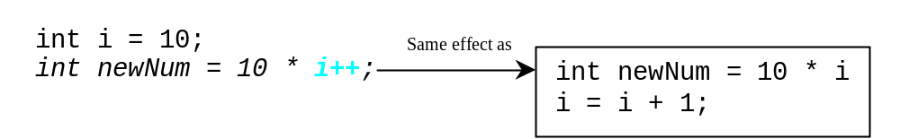
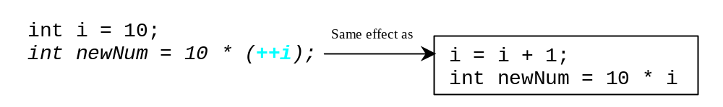
Increment and
Decrement Operators, cont.

Slide 26
Increment and
Decrement Operators, cont.
Using increment and decrement operators makes expressions short, but it also makes them complex and difficult to read. Avoid using these operators in expressions that modify multiple variables, or the same variable for multiple times such as this: int k = ++i + i.

Slide 27
Assignment Expressions and Assignment Statements
Prior to Java 2, all the expressions can be used as statements. Since Java 2, only the following types of expressions can be statements:
variable op= expression; // Where op is +, -, *, /, or %
++variable;
variable++;
--variable;
variable--;

Slide 28
Numeric Type Conversion
Consider the following statements:
byte i = 100;
long k = i * 3 + 4;
double d = i * 3.1 + k / 2;

Slide 29
Conversion Rules
When performing a binary operation involving two operands of different types, Java automatically converts the operand based on the following rules:
1. If one of the operands is double, the other is converted into double.
2. Otherwise, if one of the operands is float, the other is converted into float.
3. Otherwise, if one of the operands is long, the other is converted into long.
4. Otherwise, both operands are converted into int.

Slide 30
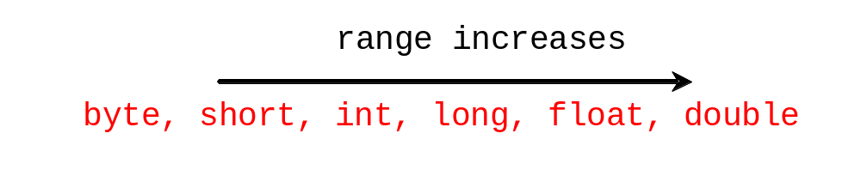
Type Casting
Implicit casting
double d = 3; (type widening)
Explicit casting
int i = (int)3.0; (type narrowing)
int i = (int)3.9; (Fraction part is truncated)
What is wrong? int x = 5 / 2.0;

Slide 31
Example: Keeping Two Digits After Decimal Points
Write a program that displays the sales tax with two digits after the decimal point.
SalesTax
Run

Slide 32
Character Data Type
Four hexadecimal digits.
char letter = 'A'; (ASCII)
char numChar = '4'; (ASCII)
char letter = '\u0041'; (Unicode)
char numChar = '\u0034'; (Unicode)
NOTE: The increment and decrement operators can also be used on char variables to get the next or preceding Unicode character. For example, the following statements display character b.
  char ch = 'a';
  System.out.println(++ch);

Slide 33

Unicode Format
Java characters use Unicode, a 16-bit encoding scheme established by the Unicode Consortium to support the interchange, processing, and display of written texts in the world’s diverse languages. Unicode takes two bytes, preceded by \u, expressed in four hexadecimal numbers that run from '\u0000' to '\uFFFF'. So, Unicode can represent 65535 + 1 characters.
Unicode \u03b1 \u03b2 \u03b3 for three Greek letters

Slide 34
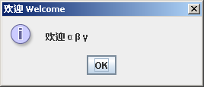
Example: Displaying Unicodes
Write a program that displays two Chinese characters and three Greek letters.
DisplayUnicode
Run

Slide 35
Escape Sequences for Special Characters
Description Escape Sequence Unicode
Backspace \b \u0008
Tab \t \u0009
Linefeed \n \u000A
Carriage return \r \u000D
Backslash \\ \u005C
Single Quote \' \u0027
Double Quote \" \u0022

Slide 36

Appendix B: ASCII Character Set
ASCII Character Set is a subset of the Unicode from \u0000 to \u007f

Slide 37

ASCII Character Set, cont.
ASCII Character Set is a subset of the Unicode from \u0000 to \u007f

Slide 38
Casting between char and Numeric Types
int i = 'a'; // Same as int i = (int)'a';
char c = 97; // Same as char c = (char)97;

Slide 39
The String Type
The char type only represents one character. To represent a string of characters, use the data type called String. For example,
String message = "Welcome to Java";
String is actually a predefined class in the Java library just like the System class and JOptionPane class. The String type is not a primitive type. It is known as a reference type. Any Java class can be used as a reference type for a variable. Reference data types will be thoroughly discussed in Chapter 6, “Classes and Objects.” For the time being, you just need to know how to declare a String variable, how to assign a string to the variable, and how to concatenate strings.

Slide 40
String Concatenation
// Three strings are concatenated
String message = "Welcome " + "to " + "Java";
// String Chapter is concatenated with number 2
String s = "Chapter" + 2; // s becomes Chapter2
// String Supplement is concatenated with character B
String s1 = "Supplement" + 'B'; // s becomes SupplementB

Slide 41
Obtaining Input
This book provides three ways of obtaining input.
Using JOptionPane input dialogs (§2.15)
Using the JDK 1.5 Scanner class (§2.16)

Slide 42
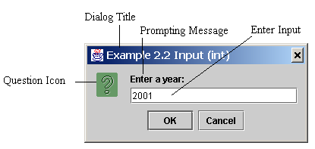
Getting Input from Input Dialog Boxes
String string = JOptionPane.showInputDialog(
null, “Prompting Message”, “Dialog Title”,
JOptionPane.QUESTION_MESSAGE));

Slide 43
Two Ways to Invoke the Method
There are several ways to use the showInputDialog method. For the time being, you only need to know two ways to invoke it.
One is to use a statement as shown in the example:
  String string = JOptionPane.showInputDialog(null, x,
  y, JOptionPane.QUESTION_MESSAGE));
where x is a string for the prompting message, and y is a string for the title of the input dialog box.
The other is to use a statement like this:
  JOptionPane.showInputDialog(x);
where x is a string for the prompting message.

Slide 44
Converting Strings to Integers
The input returned from the input dialog box is a string. If you enter a numeric value such as 123, it returns “123”. To obtain the input as a number, you have to convert a string into a number.
To convert a string into an int value, you can use the static parseInt method in the Integer class as follows:
int intValue = Integer.parseInt(intString);
where intString is a numeric string such as “123”.

Slide 45
Converting Strings to Doubles
To convert a string into a double value, you can use the static parseDouble method in the Double class as follows:
double doubleValue =Double.parseDouble(doubleString);
where doubleString is a numeric string such as “123.45”.

Slide 46
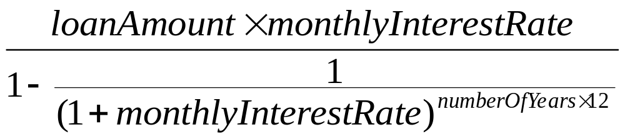
Example:
Computing Loan Payments
This program lets the user enter the interest rate, number of years, and loan amount and computes monthly payment and total payment.
ComputeLoan
Run

Slide 47
Example: Monetary Units
This program lets the user enter the amount in decimal representing dollars and cents and output a report listing the monetary equivalent in single dollars, quarters, dimes, nickels, and pennies. Your program should report maximum number of dollars, then the maximum number of quarters, and so on, in this order.
ComputeChange
Run

Slide 48
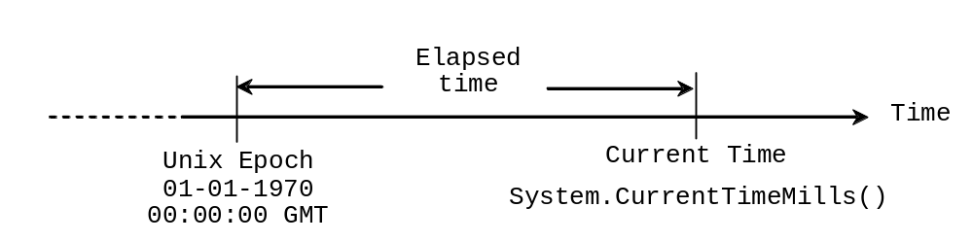
Example: Displaying Current Time
Write a program that displays current time in GMT in the format hour:minute:second such as 1:45:19.
The currentTimeMillis method in the System class returns the current time in milliseconds since the midnight, January 1, 1970 GMT. (1970 was the year when the Unix operating system was formally introduced.) You can use this method to obtain the current time, and then compute the current second, minute, and hour as follows.
ShowCurrentTime
Run

Slide 49
Getting Input Using Scanner
1. Create a Scanner object
  Scanner scanner = new Scanner(System.in);
2. Use the methods next(), nextByte(), nextShort(), nextInt(), nextLong(), nextFloat(), nextDouble(), or nextBoolean() to obtain to a string, byte, short, int, long, float, double, or boolean value. For example,
  System.out.print("Enter a double value: ");
  Scanner scanner = new Scanner(System.in);
  double d = scanner.nextDouble();
TestScanner
Run

Slide 50
Programming Style and Documentation
Appropriate Comments
Naming Conventions
Proper Indentation and Spacing Lines
Block Styles

Slide 51
Appropriate Comments
Include a summary at the beginning of the program to explain what the program does, its key features, its supporting data structures, and any unique techniques it uses.
Include your name, class section, instructor, date, and a brief description at the beginning of the program.

Slide 52
Naming Conventions
Choose meaningful and descriptive names.
Variables and method names:
  Use lowercase. If the name consists of several words, concatenate all in one, use lowercase for the first word, and capitalize the first letter of each subsequent word in the name. For example, the variables radius and area, and the method computeArea.

Slide 53
Naming Conventions, cont.
Class names:
  Capitalize the first letter of each word in the name. For example, the class name ComputeArea.
Constants:
  Capitalize all letters in constants, and use underscores to connect words. For example, the constant PI and MAX_VALUE

Slide 54
Proper Indentation and Spacing
Indentation
  Indent two spaces.
Spacing
  Use blank line to separate segments of the code.

Slide 55

Block Styles
Use end-of-line style for braces.

